Slide 1
Algorithms: Introduction
For: CSCI 163A / COEN 179
By: Navid Shaghaghi

Slide 2
Why do you need to study algorithms?
A computer Scientist has to know a standard set of important algorithms from different areas of computing.
A computer Scientist should be able to design new algorithms and
analyze their efficiency.
Algorithmics is the core of computer science.
Usefull in developing analytical skills.

Slide 3
Notes of Caution
The precision inherently imposed by algorithmic thinking limits the kinds of problems that can be solved with an algorithm. You will not find, for example, an algorithm for living a happy life or becoming rich and famous.
A person does not really understand something until after teaching it to a computer, i.e., expressing it as an algorithm - Donald Knuth, one of the most prominent computer scientists in the history of algorithmics

Slide 4
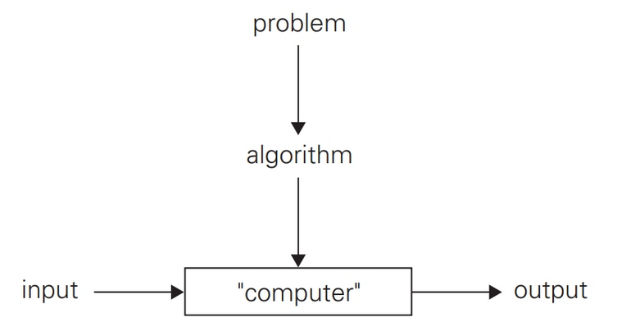
What is an Algorithm?
A sequence of unambiguous instructions for solving a problem, i.e., for obtaining a required output for any legitimate input in a finite amount of time.

Slide 5
Computing the gcd() of two integers
Problem: Find gcd(m,n), the greatest common divisor of two nonnegative, not both zero integers m and n
Examples: gcd(60,24) = 12, gcd(60,0) = 60

Slide 6
Middle-School Procedure
Step 1 Find the prime factors of m.
Step 2 Find the prime factors of n.
Step 3 Identify all the common factors in the two prime expansions found in Step 1 and Step 2. (If p is a common factor occurring p_{m} and p_{n} times in m and n, respectively, it should be repeated min{p_{m}, p_{n}} times.)
Step 4 Compute the product of all the common factors and return it as the greatest common divisor of the numbers given.

Slide 7
Example
For the numbers 60 and 24, we get
60 = 2 . 2 . 3 . 5
24 = 2 . 2 . 2 . 3
gcd(60, 24) = 2 . 2 . 3 = 12

Slide 8
Consecutive integer checking algorithm
Step 1 Assign the value of min{m, n} to t.
Step 2 Divide m by t. If the remainder of this division is 0, go to Step 3; otherwise, go to Step 4.
Step3 Divide n by t. If the remainder of this division is 0, return the value of t as the answer and stop; otherwise, proceed to Step 4.
Step 4 Decrease the value of t by 1. Go to Step

Slide 9
Euclid’s algorithm
Step 1 If n = 0, return the value of m as the answer and stop; otherwise, proceed to Step 2.
Step 2 Divide m by n and assign the value of the remainder to r.
Step3 Assign the value of n to m and the value of r to n. GotoStep1

Slide 10
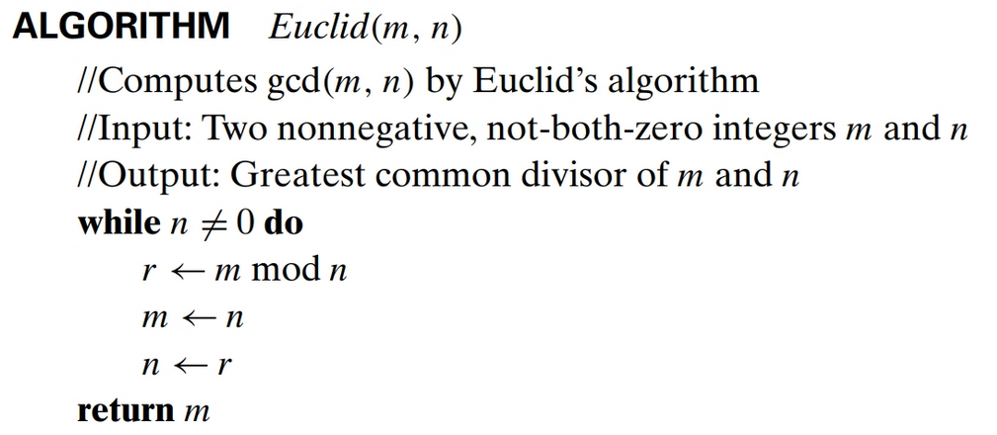
Euclid’s algorithm More Formally

Slide 11
Which of the three procedures isn’t an algorithm?
Middle-School Procedure
Why?
Because the prime factorization steps are not defined unambiguously
Why does that matter?
Unless this issue is resolved we cannot write a program implementing this procedure.
How do we fix it?
Add details for how to calculate the prime factors. Example: Sieve of Eratosthenes

Slide 12
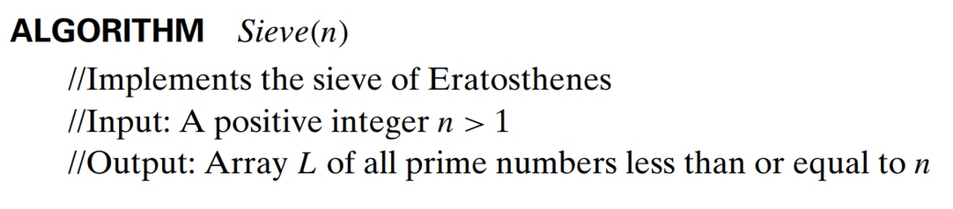
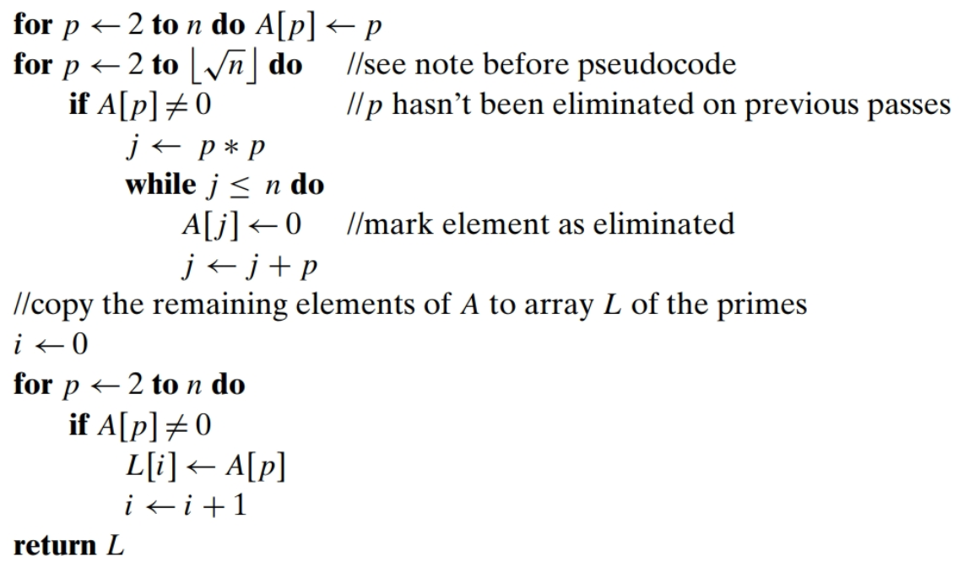

Slide 13
Example
2 3 4 5 6 7 8 9 10 11 12 13 14 15 16 17 18 19 20
See work on board

Slide 14
Fundamentals of Algorithmic Problem Solving
Algorithms are not answers but specific instructions for getting answers
There are 6 steps one typically goes through in designing and analyzing an algorithm

Slide 15
Steps for Analyzing an Algorithm
1. Understanding the Problem
2a. Ascertaining the Capabilities of the Computational Device
2b. Choosing between Exact and Approximate Problem Solving
2c. Algorithm Design Techniques
3. Designing an Algorithm and Data Structures
4. Proving an Algorithm’s Correctness
5. Analyzing an Algorithm
6. Coding an Algorithm

Slide 16
Understanding the Problem
An input to an algorithm specifies an instance of the problem the algorithm solves.

Slide 17
Ascertaining the Capabilities of the Computational Device
Von Neumann or Random Access Machine
Its central assumption is that instructions are executed one after another, one operation at a time.
Accordingly, algorithms designed to be executed on such machines are called sequential algorithms.
The central assumption of the RAM model does not hold for some newer computers that can execute operations concurrently, i.e., in parallel. Algorithms that take advantage of this capability are called parallel algorithms.

Slide 18
Should you worry about the speed and amount of memory of a computer at your disposal?
If you are designing an algorithm as a scientific exercise, the answer is a qualified no.
If you are designing an algorithm as a practical tool, the answer may depend on a problem you need to solve.
Even the “slow” computers of today are almost unimaginably fast.
There are important problems, however, that are very complex by their nature, or have to process huge volumes of data, or deal with applications where the time is critical or memory is limited (such as in microcontrollers). In such situations, it is imperative to be aware of the speed and memory available on a particular computer system.

Slide 19
Algorithm Design Techniques
Technique = strategy = paradigm
a general approach to solving problems algorithmically that is applicable to a variety of problems from different areas of computing.
Learning these techniques is of utmost importance because
they provide guidance for designing algorithms for new problems (Akin to: Learning to fish as opposed to being given a fish)
they make it possible to classify algorithms according to an underlying design idea; therefore, they can serve as a natural way to both categorize and study algorithms.

Slide 20
Methods of Specifying an Algorithm
Natural Language
Pseudocode
Flowchart
Computer Program written in a particular computer Language

Slide 21
Proving an Algorithm’s Correctness
Correctness: the algorithm yields a required result for every legitimate input in a finite amount of time.
Example: the correctness of Euclid’s algorithm for computing the greatest common divisor stems from the correctness of the equality gcd(m, n) = gcd(n, m mod n) (which, in turn, needs a proof).
tracing the algorithm’s performance for a few specific inputs cannot prove the algorithm’s correctness conclusively. But in order to show that an algorithm is incorrect, you need just one instance of its input for which the algorithm fails.
For an approximation algorithm, we usually would like to be able to show that the error produced by the algorithm does not exceed a predefined limit.

Slide 22
Analyzing an Algorithm
Space efficiency
Time Efficiency
Simplicity
simpler algorithms are easier to understand and easier to program; consequently, the resulting programs usually contain fewer bugs.
Generality
of the problem the algorithm solves
Of the set of inputs the algorithm accepts
A designer knows he has arrived at perfection not when there is no longer anything to add, but when there is no longer anything to take away.”

Slide 23
Coding an Algorithm
Improvements can speed up a program only by a constant factor, whereas a better algorithm can make a difference in running time by orders of magnitude.
Optimality: What is the minimum amount of effort any algorithm will need to exert to solve the problem?

